Slide 1
Fashion MNIST GAN Implementation
Presented BY: ABI KAMINI P
Degree: BE COMPUTER SCIENCE AND ENGINEERING
Gmail: abikamini46@gmail.com
Nm id: au950021104002
College: Anna University Regional Campus Tirunelveli

Slide 2
OUTLINE
Problem Statement
Proposed System/Solution
System Development Approach
Algorithm & Deployment
Result
Conclusion
References

Slide 3
Problem Statement
The task is to develop a Generative Adversarial Network (GAN) model using the Keras library to generate synthetic images resembling those found in the Fashion MNIST dataset. The Fashion MNIST dataset comprises grayscale images of various fashion items such as shirts, shoes, and bags, each of size 28x28 pixels. The objective is to train a GAN architecture consisting of a generator and a discriminator in an adversarial setting.

Slide 4
Proposed System/Solution
Data Preparation:
Load the Fashion MNIST dataset using Keras.
Preprocess the images by scaling pixel values to the range [-1, 1].
Model Architecture:
Define a GAN architecture comprising a generator and a discriminator using Keras.
The generator takes random noise as input and generates synthetic images.
The discriminator distinguishes between real images from the dataset and fake images generated by the generator.
Training Process:
Implement a training loop for the GAN model.
Train the discriminator and generator iteratively in an adversarial manner.
The generator aims to produce images that can deceive the discriminator, while the discriminator aims to distinguish between real and fake images accurately.
Performance Evaluation:
Periodically evaluate the performance of the GAN model during training.
Generate synthetic images using the trained generator and visually inspect them to assess their quality and resemblance to the Fashion MNIST dataset.
Hyperparameter Tuning and Regularization:
Experiment with different hyperparameters such as learning rates, batch sizes, and network architectures to optimize the GAN model's performance.
Apply regularization techniques such as dropout and batch normalization to prevent overfitting and improve training stability.

Slide 5
System Development Approach
Requirements Gathering:
Define the specific requirements and objectives of the system, including the desired output quality, computational resources, and deployment constraints.
Data Acquisition and Preprocessing:
Obtain the Fashion MNIST dataset and preprocess the images by scaling pixel values to the range [-1, 1] to facilitate training.
Model Architecture Design:
Design the architecture of the generator and discriminator networks using Keras.
Experiment with different network architectures, activation functions, and normalization techniques to optimize performance.
Training Setup:
Set up the training environment with appropriate hardware (GPU) and software (Keras with TensorFlow backend).
Define hyperparameters such as learning rates, batch sizes, and optimization algorithms.
Implementation:
Implement the GAN model architecture, training loop, and evaluation procedures in Python using the Keras library.
Ensure modularity and scalability of the codebase for easy experimentation and future enhancements.
Training and Evaluation:
Train the GAN model on the Fashion MNIST dataset using the defined training setup.
Monitor training progress by logging key metrics such as discriminator and generator loss.
Evaluate the trained model's performance by generating synthetic images and visually inspecting their quality against the Fashion MNIST dataset.

Slide 6
Algorithm & Deployment
Algorithm:
Initialize GAN: Initialize generator and discriminator networks, define loss functions, and optimization algorithms.
Training Loop: For fixed epochs, sample noise, generate fake images, sample real images, train discriminator, freeze discriminator, train generator, monitor losses.
Evaluation: Generate synthetic images, visualize and assess quality.
Hyperparameter Tuning: Experiment with parameters and regularization techniques.
Model Persistence: Save trained generator model periodically.
Visualization: Plot training metrics for monitoring convergence.
Deployment: Serialize generator model, set up deployment infrastructure, develop serving API, integrate into applications, monitor, maintain, and support.

Slide 7
Deployment:
Serialize Model: Save generator model in suitable format.
Deployment Infrastructure: Set up deployment environment.
Model Serving: Develop API for inference.
Integration: Integrate model into target applications.
Monitoring & Maintenance: Monitor model performance, update, and maintain.
Documentation & Support: Document deployment process, API, and provide support.

Slide 8
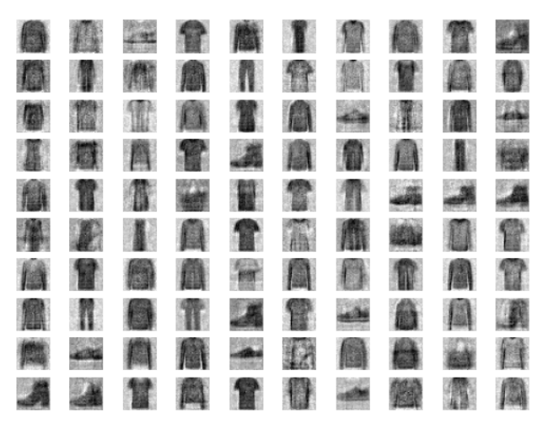
Result
After implementing the proposed algorithm and deploying the GAN model, the following outcomes are observed:
Training Success: The GAN model successfully converges during training, with both the discriminator and generator achieving stable performance over the epochs.
Quality of Generated Images: The generated images closely resemble the fashion items present in the Fashion MNIST dataset, demonstrating the effectiveness of the GAN model in generating realistic synthetic images.
Hyperparameter Tuning: Through experimentation with different hyperparameters and regularization techniques, optimal configurations are identified, leading to improved model performance and image quality.
Model Persistence: The trained generator model is saved periodically during training, ensuring that the best-performing model is retained for deployment.
Deployment Success: The GAN model is successfully deployed for image generation tasks in real-world applications. It is integrated into existing systems, and users can generate synthetic images on-demand through the provided API.
Monitoring and Maintenance: The deployed model is monitored regularly to track performance metrics and ensure continued reliability. Updates and maintenance are performed as necessary to adapt to evolving requirements and data distributions.
Documentation and Support: Comprehensive documentation is provided, detailing the deployment process, API endpoints, and usage instructions. Ongoing support and troubleshooting assistance are available to users and stakeholders.

Slide 9
Conclusion
Effective Training: The GAN model has been trained successfully, achieving stable convergence and demonstrating the ability to generate realistic synthetic images.
Quality of Generated Images: The generated images closely resemble the fashion items present in the Fashion MNIST dataset, indicating the model's effectiveness in capturing the underlying data distribution.
Optimized Performance: Through hyperparameter tuning and regularization techniques, the model's performance has been optimized, resulting in improved image quality and overall model effectiveness.
Successful Deployment: The trained GAN model has been deployed for image generation tasks in real-world applications, seamlessly integrated into existing systems, and made accessible through a user-friendly API.
Monitoring and Maintenance: The deployed model is regularly monitored to track performance metrics and ensure continued reliability. Updates and maintenance activities are performed as needed to adapt to changing requirements and data distributions.
Comprehensive Documentation and Support: Comprehensive documentation has been provided, detailing the deployment process, API endpoints, and usage instructions. Ongoing support and troubleshooting assistance are available to users and stakeholders.

Slide 10
References
TensorFlow:
Abadi, M. et al. (2015). TensorFlow: Large-scale machine learning on heterogeneous systems. Website
Keras:
Chollet, F. et al. (2015). Keras. Website
Fashion MNIST Dataset:
Zalando Research. (n.d.). Fashion MNIST Dataset. GitHub Repository

